Slide 1















Project presentation
Presented by MAYNAK RAJ
22BAI1118

Slide 2

DataBase Design
Introduction
This document presents the database design for a sample e-commerce management system. This model represents the real world entities and their relationships involved in the online shopping process. The following sections will present the ERD, relational schema design, and normalization of this model.

Slide 3
Requrements:
Shopping Cart
• Users can brows and add products to their shopping cart.
• Logged-in users can save their shopping carts for later checkout.
03.
Following are the functional requirements for the application.
User Management:
• Users can create accounts to login in to the website.
• Users can update their profile information, including contact details.
Order Processing:
• Users can submit orders with their selected products quantities, and shipping addresses.
• Users can choose from a list of available shipping methods.
01.
04.
Product Management:
• Website allows for adding and managing products with various categories and variations (e.g. size, color)
• The system tracks the number of products in stock.
Order Status and tracking:
• Users can view the status of their orders (processing, shipping, delivered)
02.
01.

Slide 4
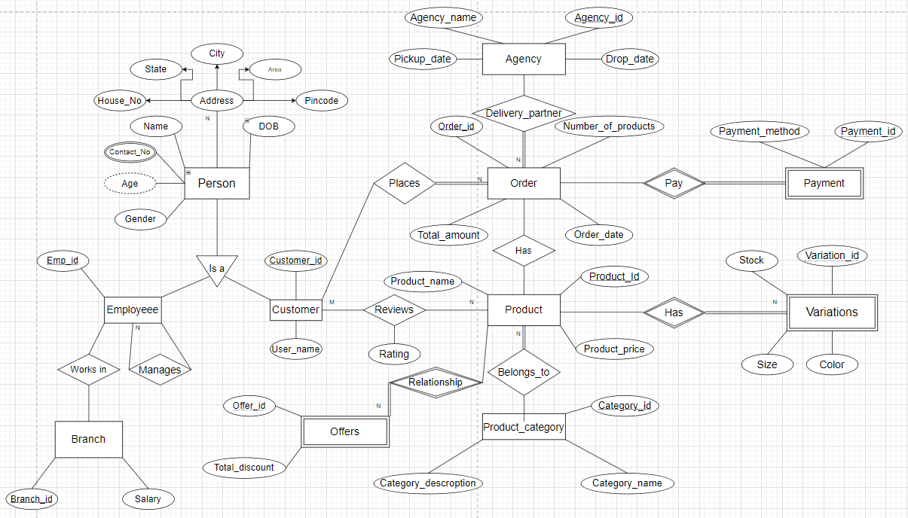
Entity–Relationship model
M

Slide 5
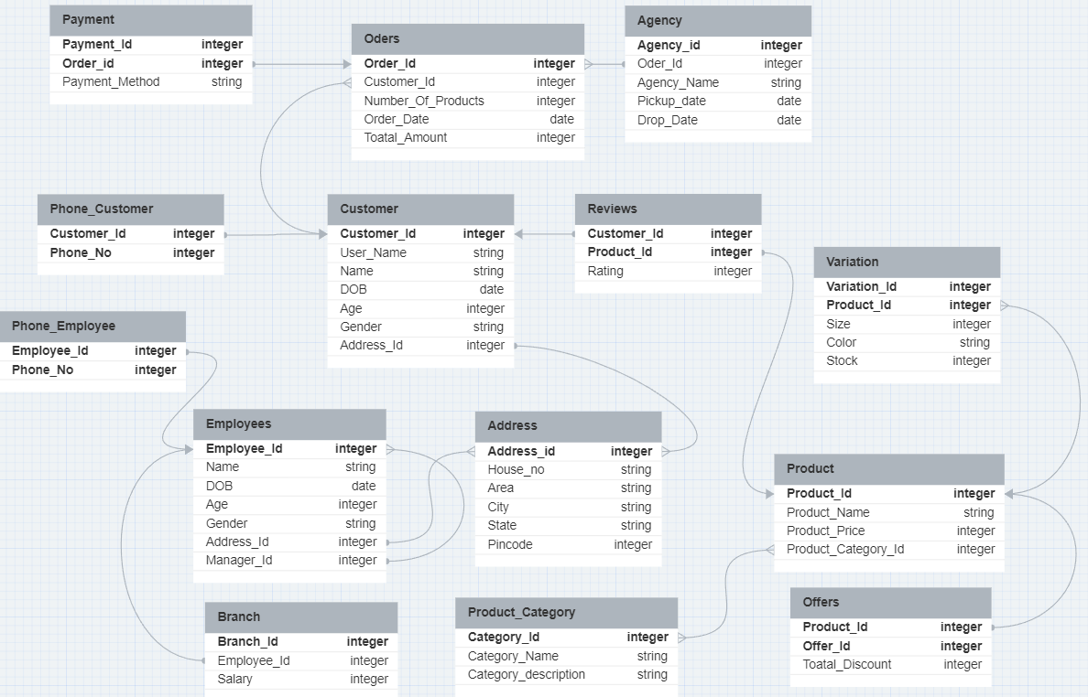
Relational Schema Design

Slide 6
SQL queries
CREATE TABLE Customers ( Customer_Id INTEGER PRIMARY KEY,
User_Name VARCHAR(50), Name VARCHAR(50),
DOB DATE, Age INTEGER, Gender VARCHAR(20), Address_Id INTEGER REFERENCES Address(Address_id)
);
CREATE TABLE Address (
Address_id INTEGER PRIMARY KEY, House_no VARCHAR(255),
Area VARCHAR(255),
City VARCHAR(255),
State VARCHAR(255),
Pincode INTEGER
);
CREATE TABLE Phone_Customer ( Customer_Id INTEGER REFERENCES Customers(Customer_Id),
Phone_No INTEGER,
PRIMARY KEY (Customer_Id, Phone_No)
);
01
02
03
CREATE TABLE Employees ( Employee_Id INTEGER PRIMARY KEY, Name VARCHAR(50),
DOB DATE, Age INTEGER,
Gender VARCHAR(20),
Address_Id INTEGER REFERENCES Address(Address_id),
Manager_Id INTEGER REFERENCES Employees(Employee_Id)
);
CREATE TABLE Phone_Employee ( Employee_Id INTEGER REFERENCES Employees(Employee_Id),
Phone_No INTEGER,
PRIMARY KEY (Employee_Id, Phone_No) );
CREATE TABLE Branch (
Branch_Id INTEGER PRIMARY KEY,
Employee_Id INTEGER REFERENCES Employees(Employee_Id),
Salary INTEGER
);
04
05
06

Slide 7
SQL queries
CREATE TABLE Product_Category ( Category_Id INTEGER PRIMARY KEY,
Category_Name VARCHAR(255), Category_description VARCHAR(255)
);
CREATE TABLE Product (
Product_Id INTEGER PRIMARY KEY, Product_Name VARCHAR(255), Product_Price INTEGER, Product_Category_Id INTEGER REFERENCES Product_Category(Category_Id)
);
CREATE TABLE Reviews ( Customer_Id INTEGER REFERENCES Customers(Customer_Id), Product_Id INTEGER REFERENCES Product(Product_Id),
Rating INTEGER, PRIMARY KEY (Customer_Id, Product_Id)
);
07
08
09
CREATE TABLE Orders (
Order_Id INTEGER PRIMARY KEY, Customer_Id INTEGER REFERENCES Customers(Customer_Id), Number_Of_Products INTEGER, Order_Date DATE,
Total_Amount INTEGER
);
CREATE TABLE Agency (
Agency_id INTEGER PRIMARY KEY, Order_Id INTEGER REFERENCES Orders(Order_Id),
Agency_Name VARCHAR(255), Pickup_date DATE,
Drop_Date DATE
);
CREATE TABLE Offers (
Product_Id INTEGER REFERENCES Product(Product_Id),
Offer_Id INTEGER,
Total_Discount INTEGER,
PRIMARY KEY (Product_Id, Offer_Id) );
10
11
12

Slide 8
SQL queries
CREATE TABLE Payment ( Payment_Id INTEGER PRIMARY KEY, Order_id INTEGER REFERENCES Orders(Order_Id), Payment_Method VARCHAR(255)
);
CREATE TABLE Variation (
Variation_Id INTEGER,
Product_Id INTEGER REFERENCES Product(Product_Id),
Size INTEGER,
Color VARCHAR(255),
Stock INTEGER,
PRIMARY KEY (Variation_Id, Product_Id)
);
13
14

Slide 9
First Normal Form
1NF requirements:
• Single-valued attributes: Each cell in a table can contain only one single value.
• No repeating groups: There shouldn’t be any repeating sets of columns within a table.
Therefore no further change it required to get the tables in 1NF form

Slide 10
Second Normal Form
2NF requirements:
• No partial dependency: All non-key attributes (attributes not part of the candidate key(s)) must be fully dependent on the entire primary key (the minimum set of attributes that uniquely identifies each row in the table). This means: A non-key attribute cannot be determined solely by a proper subset of the primary key. Every non-key attribute must be completely determined by the entire primary key, not just a part of it.

Slide 11
Changes
CREATE TABLE Employees ( Employee_Id INTEGER PRIMARY KEY,
Name VARCHAR(50),
DOB DATE, Age INTEGER,
Gender VARCHAR(20),
Address_Id INTEGER REFERENCES Address(Address_id),
Department_Id INTEGER REFERENCES DepartmentDepartment_Id)
);
CREATE TABLE Department ( Department_id INTEGER PRIMARY KEY, Manager_Id INTEGER,
CONSTRAINT fk_manager FOREIGN KEY (Manager_Id) REFERENCES Employees(Employee_Id)
);
01
02

Slide 12
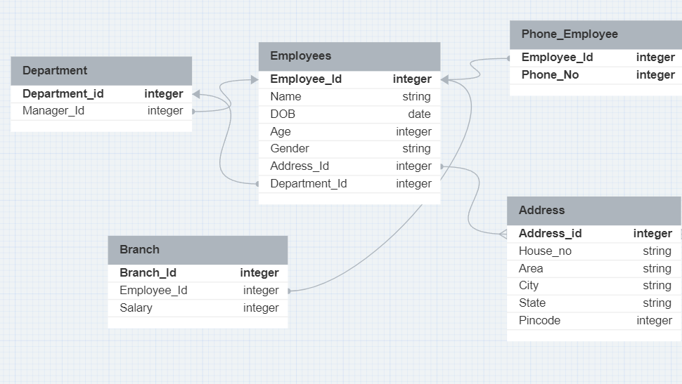
Changes

Slide 13
Third Normal Form
3NF requirements:
• Eliminate Transitive Dependency: All non-key attributes must be fully dependent on the entire primary key or on another candidate key.
This means: No non-key attribute can be determined by another non-key attribute which itself is not fully dependent on the primary key.
All non-key attributes must be directly dependent on the primary key or a candidate key, preventing any ”chain of dependencies” where one non-key attribute relies on another to ultimately reach the primary key.

Slide 14
Changes
CREATE TABLE Orders (
Order_Id INTEGER PRIMARY KEY, Customer_Id INTEGER REFERENCES Customers(Customer_Id),
Order_Date DATE, Total_Amount INTEGER
);
CREATE TABLE Order_details (
Order_Id INTEGER,
Product_Id INTEGER,
Quantity INTEGER,
PRIMARY KEY (Order_Id, Product_Id),
CONSTRAINT fk_order FOREIGN KEY (Order_Id) REFERENCES Orders(Order_Id),
CONSTRAINT fk_product FOREIGN KEY (Product_Id) REFERENCES Product(Product_Id)
);
01
02

Slide 15
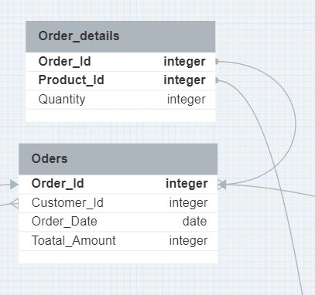
Changes

Slide 16
4NF, 5NFand Boyce–Codd normal form
Boyce-Codd Normal Form (BCNF):
Remove non-trivial functional dependencies on a superkey. Every determinant (non-prime attribute) must be a candidate key. Ensure that there are no non-prime attributes functionally dependent on a proper subset of a candidate key.
4th Normal Form (4NF):
Eliminate multivalued dependencies. Each non-prime attribute is fully functionally dependent on every superkey.
5th Normal Form (5NF):
Address lossless-join decomposition. Handle cases where a relation is decomposed into smaller relations without losing information. Minimize redundancy and dependency.
Therefore no further change it required.

Slide 17
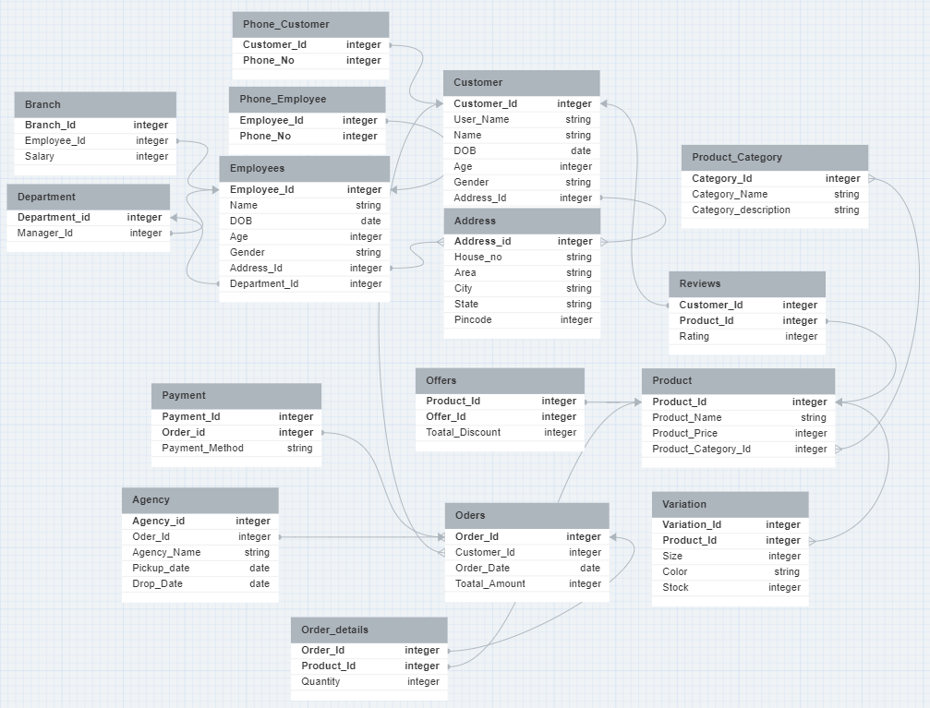
Final Schema

Slide 18
Improvements
Normalization: My tables are normalized, reducing redundancy and minimizing data anomalies. For example, the separation of the Customers and Address tables helps to avoid repeating address information for each customer.
Relationships: I have defined relationships between tables using foreign keys, which is crucial for maintaining data integrity. For instance, the relationship between Customers and Address, Employees and Address, and others.
Primary and Foreign Keys: The use of primary keys and foreign keys is appropriate, providing a solid foundation for relational integrity and aiding in data retrieval and management.
Logical Structure: The tables represent logical entities within the e-commerce domain, making it easier to understand and maintain the database.

Slide 19
Thank you

